Slide 1

Sales & Distribution
SAP ECC-EHP-8

Slide 2
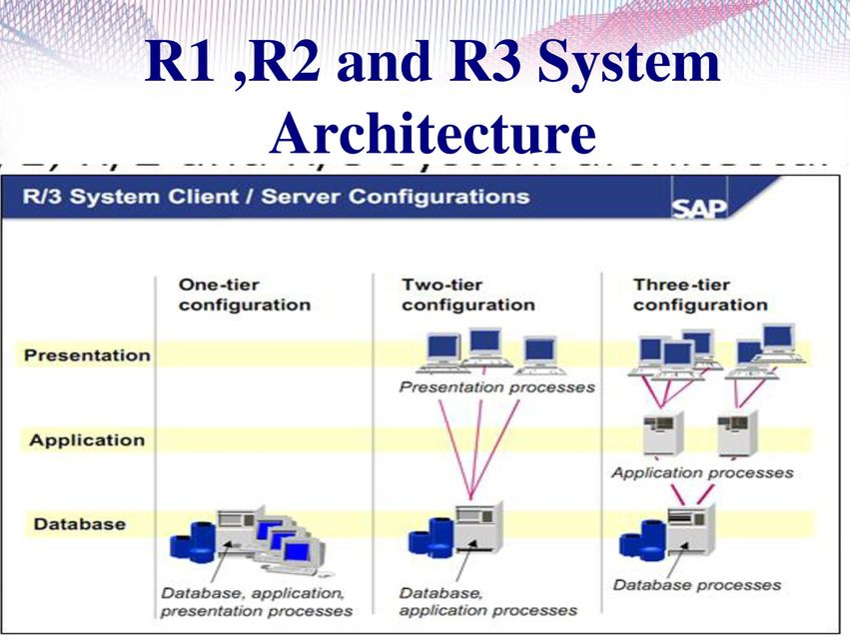
History of SAP
Founded in 1972 by Wellenreuther, Hopp, Hector, Plattner and Tschira
Renamed in 1977
Before 1977 : Systems Analysis and Program Development (German : Systemanalyse und Programmentwicklung)
There are three systems introduced in SAP – R1, R2, R3 (R → Real-time data processing)
Development
Quality
Pre-production
Production
System Landscape
Client – Complete Set of SAP

Slide 3

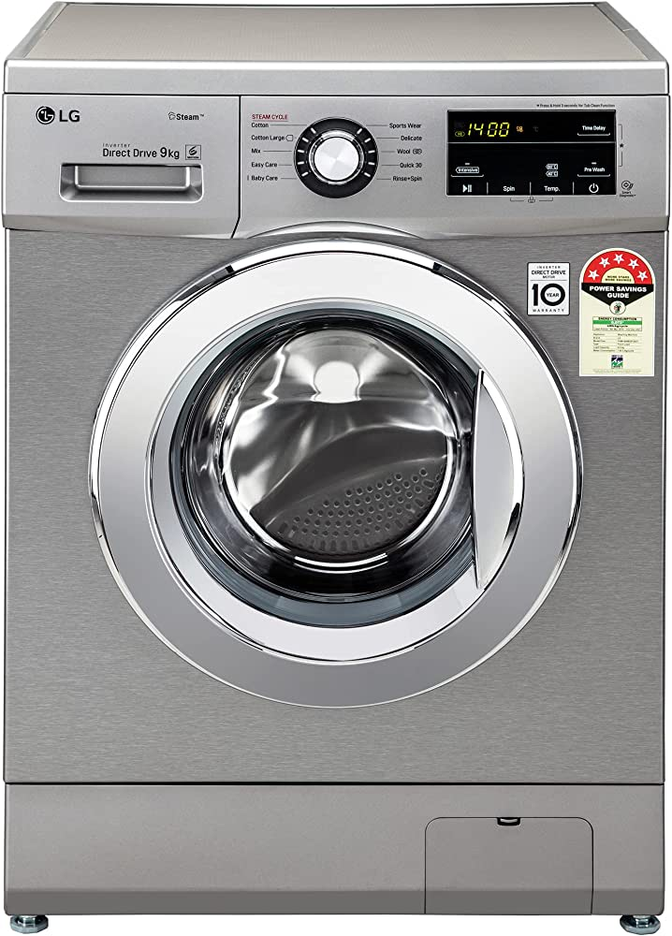
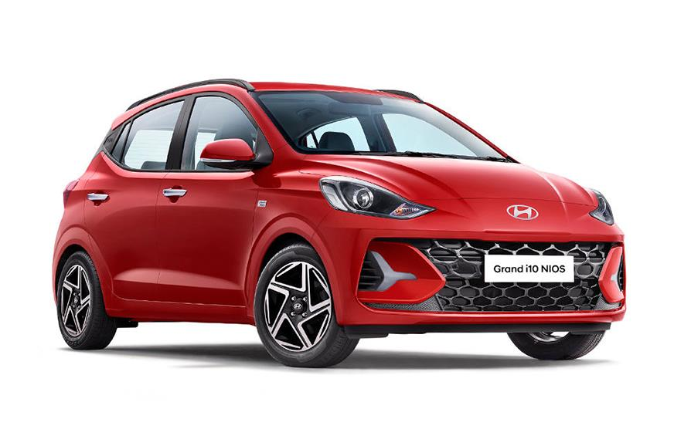
ERP Introduction
ERP → Enterprise Resource Planning
E → Enterprise → Any organisation/business not limited to one
R→ Resources → 3M’s
Money(Finance)
Manpower
Material(Product/Service)
P → Optimization→ effective usage – how..????
Manufacturing
Repetitive
Discrete
Process
Bill of Materials
Formula/ Recipes

Slide 4
SAP
Supply chain process
Right Quantity
Right Time
Right Place
Continuously

Slide 5
SAP
Systems, Applications & Products in Data Processing
Customer
Sales
Inventory
Production
Delivery
Finance
HR
Vendor/ Raw Material

Slide 6
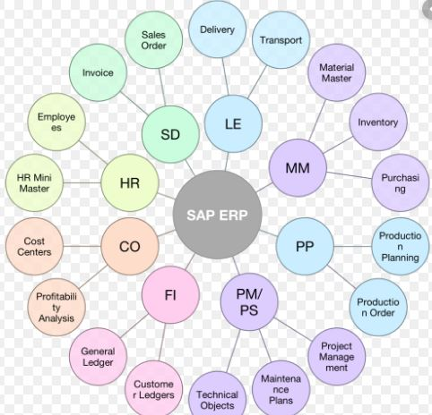
SAP Modules
Seamless Integration of all modules
Best practice
Mother of all modules

Slide 7
SAP Software
BASIS
Security & Authorization
ABAP
Functional Consultant
Manage SAP environment
Customisation
Configuration

Slide 8
ERP → Optimized used of 3M’s
Organisation Structure
Master Data
Configuration
Transaction
Reports/Bill

Slide 9
SD Module – Sales and Distribution
Product/Service
Customer
Price
Tax – Law of Land

Slide 10
Implementation Methodology → ECC ASAP Methadology
ERP Central Component
Green Field
Brown Field
Project Kick-off
AS IS → TO BE (BBP/BPM)
Realisation
Go Live
Support
Formation of teams – Client & SAP → Nucleus/Core Team member → Sign off/ Milestone
Storytelling/ Detailing of business process → Department wise → Legacy System → System GAP/Process NA
Actual Config. → As per AS IS TO BE (Development Stage)
Data Migration/ Cut-over activity
SOW→Hypercare →Handle queries of the end user

Slide 11
Sales and distribution processing
Sales activity
Inquiry
Quotation
Sales Order
Delivery
Invoice
Sales Support
Sales
Delivery free of charge
Subsequent delivery free of charge
Returns
Scheduling agreement
Shipping
Billing
Debit Memo
Credit Memo
Financial Accounting

Slide 12
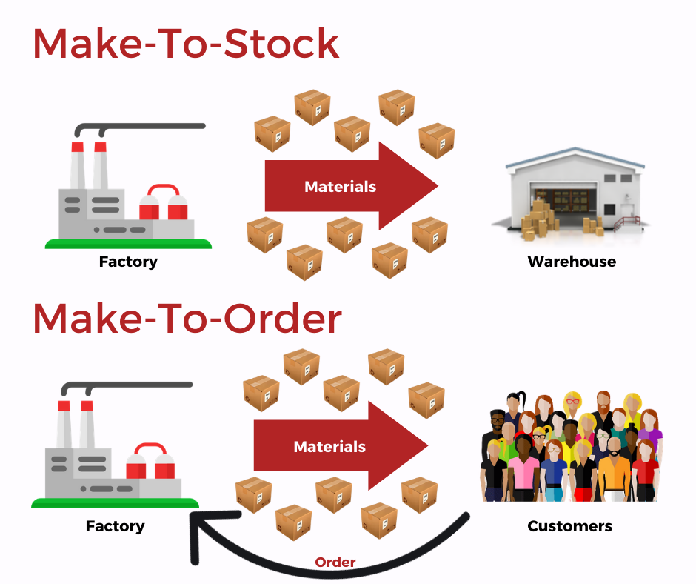

Slide 13
Organisation Structure
Reliance Group of Companies
Reliance Telecommunication
Mobile Phone
Broadband
Corporate
Retail
Non-Smart Phones
Smart Phones
Smart Phones
Non-Smart Phones
Corporate
Hi Speed
Low Speed
Retail
Hi Speed
Low Speed
Highest Level in FI Module
Company
Company Code
Highest Level in SD Module
Sales Organisation
Distribution Channel
Division

Slide 14
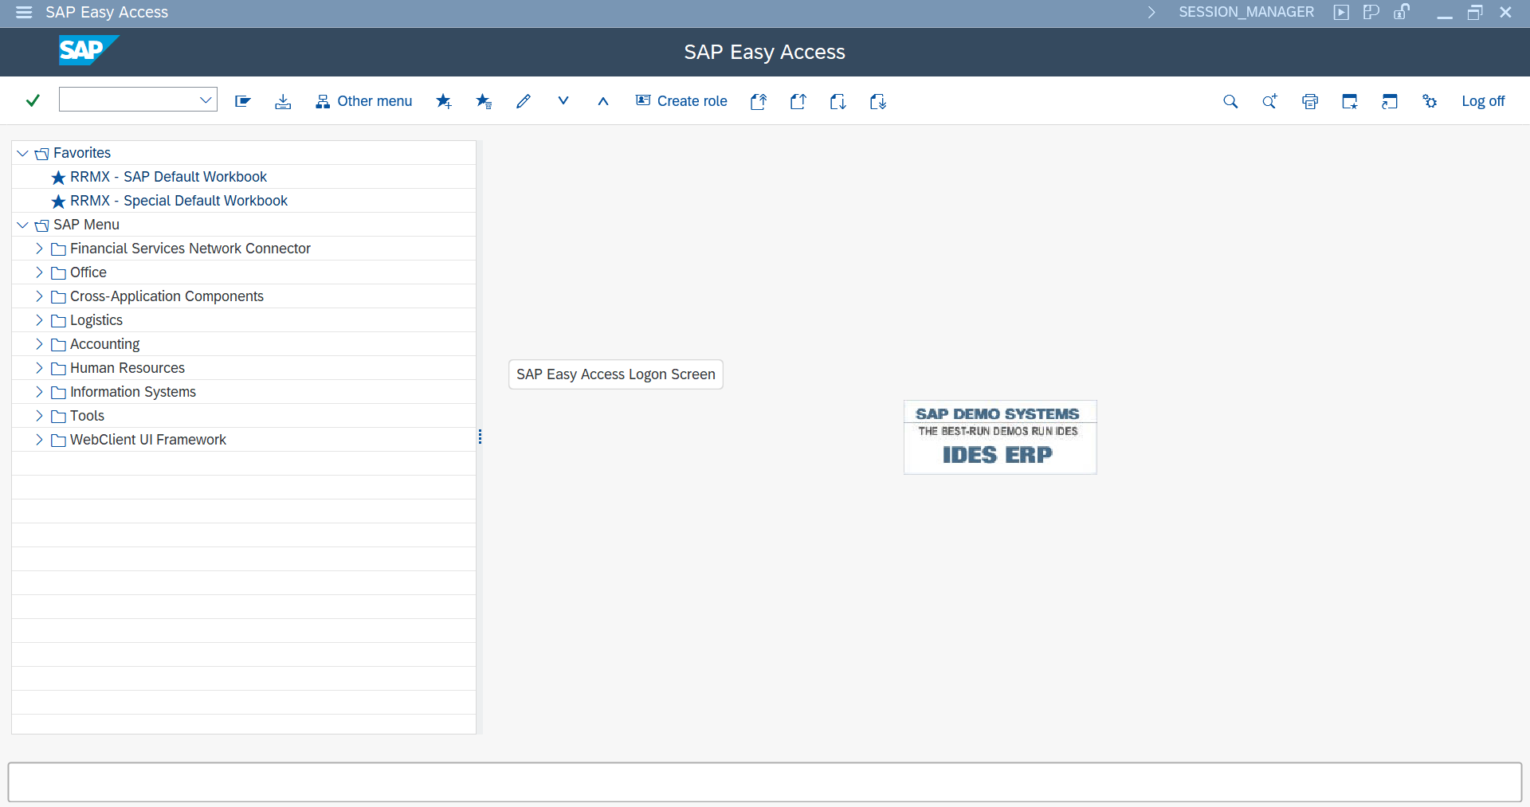
Menu Bar
Transaction Bar
Display Bar

Slide 15

Icons in SAP
Done button
To go back to previous screen – changes will not be saved
T Code
/nXXX – new window
/oXXX – additional window
Save button
To save the changes
New Entries
To add new data
Copy
Select All
Cancel Button
To discard any changes
First Page
Delete
Select Block
Previous Page
Change Button
Move from change screen to display screen
Undo
Deselect All
Next Page
Last Page
Detail Button
Consists of lots of function
Position Button
Used to search the required field

Slide 16
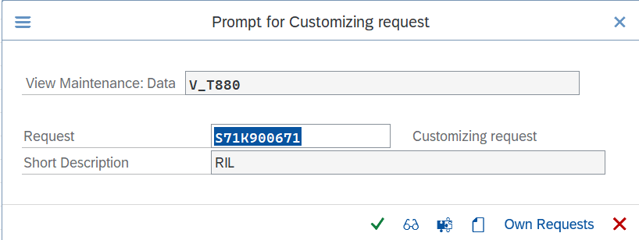
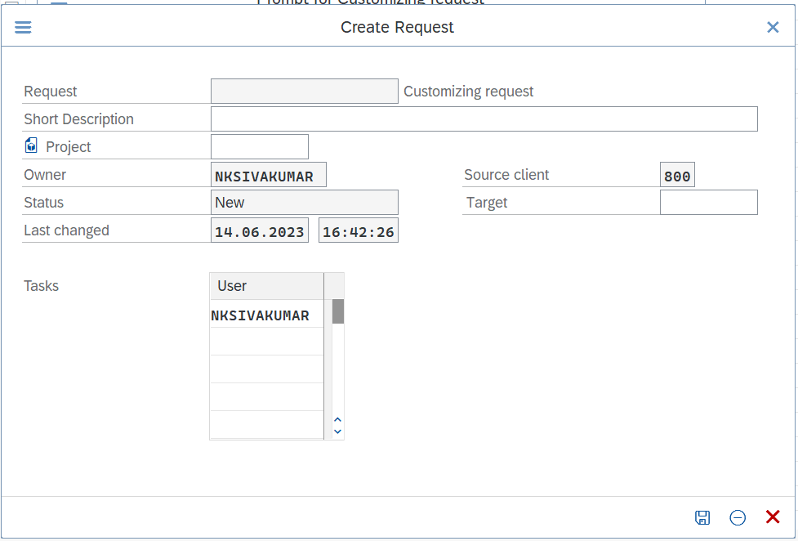
Transportation Request
Every time a change is made and saved, Transportation Request is raised. A transport request records all changes to development objects.
Always enter the action e.g. Company Creating along with date and hypen number to sequence the transport request
NSS-COMPANY CODE CREATION-1406-1

Slide 17
Agenda
Session 1 | Master Data | SAP introduction
Session 2 |  | Organisation Structure
Session 3 |  | Customer Creation
Session 4 |  | Material Creation
Session 5 |  | Assigning Sales Document to Sales org
Session 6 | Transactions | Initial Stock updation
Session 7 |  | Inquiry
Session 8 |  | Quotation
Session 9 |  | O2C, cancellation of sales order
Session 10 |  | Debit Memo, Credit Memo, Cash Sales, Returns
Session 11 |  | Scheduling Agreement, Value Contract
Session 12 |  | Consignment
Session 13 | Configuration | Pricing configuration
Session 14 |  | Tax Determination
Session 15 |  | Condition Technique
Session 16 |  | Transportation Request
Session 17 |  | Sales Document fields - item and head level
Session 18 |  | Account Determination
Session 19 |  | Incompletion Log
Session 20 |  | Free goods
Session 21 |  | Third Party Order
Session 22 |  | Credit Management
Session 23 |  | Stock Transfer Order
Session 24 |  | Output Determination
Session 25 |  | Tables - for all steps
Session 26 |  | Determinations

Slide 18
Organisation Structure Creation
ec01 → Organisational structure check
Define
Assignment
Company
Company Code
Credit Control Area
Plant
Division
Sales Organisation
Distribution Channel
Storage Location
Shipping point
Company → Company Code
Company Code → Credit Control Area
Company Code → Plant
Sales Organisation → Company Code
Sales Organisation → Distribution Channel
Sales Organisation → Division
Sales area
Sales Organisation → Distribution Channel → Plant
Sales Area → Credit Control Area
Shipping Point → Plant
Financial Accounting
Financial Accounting
Logistics General
MM + FI
Logistics - General
SD + MM
Sales & Distribution
Sales& Distribution
SD + MM
Material Management
Logistics Execution
Logistics Execution

Slide 19
Customer Master →Account Group
Sold to
Ship to
Bill to
Payer
Sold to Party
Ship to Party
Bill to Party
Payer
Account/address who places the order → Sales agreement is issued in their name → Unique
Account/address to which to product/services is sent
Statutory Legal Document → Invoice is generated to this account/address
Payer is where the account which pays for the goods/services that is sent

Slide 20
Tables
Customer Master
Material master
MARA - Material Master: General data
MAKT - Material Master: Description
MARM - Material Master: Unit of Measure
MARC - Material master: Plant data
MARD - Material master: Storage location
KNA1 – General Data
KNVV – Sales Data
KNVP – Company Code Data
Functional Specific Writing
Go to tables se16n → in field KUNNR = 5000047 → take ADRNR→ from the address and display the street name and pin code in the invoice

Slide 22
Sales Document Types
Choose the sales document type
Copy the standard sales doc type and create a new sales doc type – VOV8
Assign the sales document to the respective sales area -OVAZ
Type of Processing | Sales Document Type | Abbreviation
Presales | Inquiry | IN
 | Quotation | QT
 | Free-of-charge delivery | FD
Sales orders | Standard sales order | OR
 | Cash sale | BV
 | Rush order | SO
Outline agreements | Quantity contract | CQ
 | Scheduling agreement | DS
Complaints | Credit memo request | CR
 | Debit memo request | DR
 | Subsequent delivery Free-of-charge | SD
 | Returns | RE
Consignment | Consignemnt Fill-up | CF
 | Consignment Pickup | CP
 | Consignment Issue | CI
 | Consignment Return | CONR
Always copy and use the standard sales document types. Eg. ZIN

Slide 23
Credit Memo Request Vs Debit Memo Request
Credit memo request
Debit memo request
Reduces the amount receivable from customers.
Reduces the amount payable to the customer.
All debit memo request and credit memo request creates a block in the billing which has to be approved by the FI for billing.
The credit is given to customer for reasons like : Damage, Lesser weight, missing quantity, etc
The debit is given to the customer for reasons like : The amount paid by the customer is lower than the invoice, weight inaccuracies, etc

Slide 24
Cash Sales VS Rush Order
Cash sales
Rush order
The customer pays for the goods immediately after picking them up from the warehouse. The delivery is processed as soon as the order has been made. A cash invoice can be printed immediately from the order and billing is related to the order.
The customer picks up the goods immediately, as when the order was created. But the customer does not pay immediately after picking up the goods. delivery is automatically created. Billing takes place as normal, after the delivery.
Cash Sales
Sales Order → Delivery → Billing
Rush Order

Slide 25
Consignment Process
→ Products are stored at the customer location but the owner of this product is still the company
→ Customers can consume products from the warehouse at any time and the customer is billed for the product for the actual quantity consumed.
Consignment Type | What happens ? | Action
Consignment Fill-up | Company store product at customer sites and still the company is the owner. | Only order and delivery takes place.
Consignment Issue | Company will issue invoices for only accessed product | Only delivery and Invoices take place.
Consignment Pick-up | Customer return product due to damage ,poor quality, expiry. | Delivery, Invoices and Credit for return take place.
Consignment Return | Take back the product, the company will pack this product from customer sites | Pickup Order,Return Delivery takes place

Slide 26
Create Sales Document Type – ZCR, ZDR, ZRE, ZRO, ZCS
Assign sales doc to the sales area
Logistics Execution → Shipping point determination –
SC – 07, 10, A008 plant ( 01 already exist)
Create Sales Order Types
Credit Memo Request
Debit Memo Request
Rush Order
Cash Sales
Returns

Slide 27
Tax Determination
 | Customer | Material/ Service | Final
Type 1 | 0 | 0 | 0
Type 2 | 0 | 1 | 0
Type 3 | 1 | 0 | 0
Type 4 | 1 | 1 | 1
CGST
SGST
IGST
UGST

Slide 28
Value Contract
Copy and create Value contract from sales document type
Check the document pricing procedure
Add the DPP in pricing determination – ovkk – contract- Y

